Slide 1



AGRITRUST
ENSURING TRANSPARENCY, TRUST & FRESHNESS IN AGRICULTURE
Team Name: KOKOLA
Theme: Supply Chain
Team Members: Deva Priya R, Nehal Gupta, Pragna Kulkarni

Slide 2
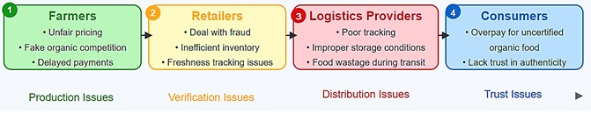
PROBLEM STATEMENT
The farm-to-table supply chain lacks transparency and trust, leading to counterfeit organic products, unfair pricing for farmers, inefficient logistics, and food wastage due to poor freshness tracking.
REAL-WORLD EXAMPLE
Ramesh, an organic farmer, sends his produce to the market, but due to a lack of transparency, his vegetables get mixed with non-organic ones, falsely labeled, and undervalued.
Meanwhile:
Consumers like Priya pay extra for organic produce but can't verify its authenticity.
Retailers face complaints about freshness, leading to refund losses.
This results in losses for farmers, distrust among consumers, and inefficiencies in the supply chain.
WHO IS AFFECTED?

Slide 3
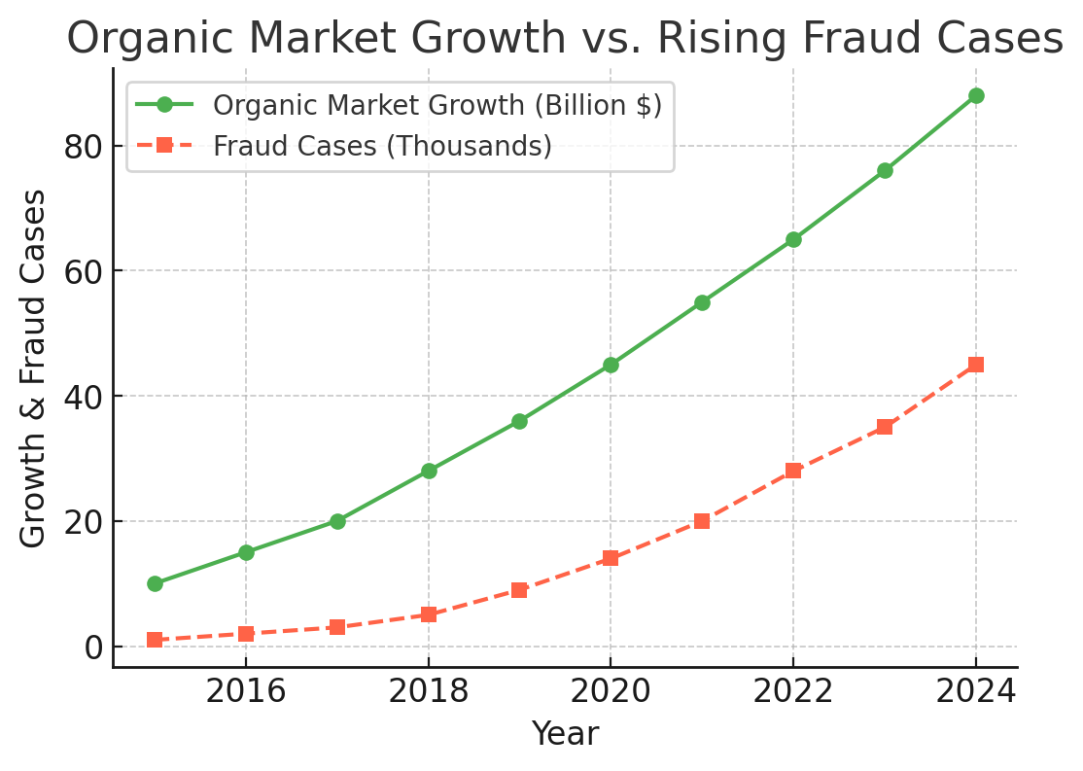
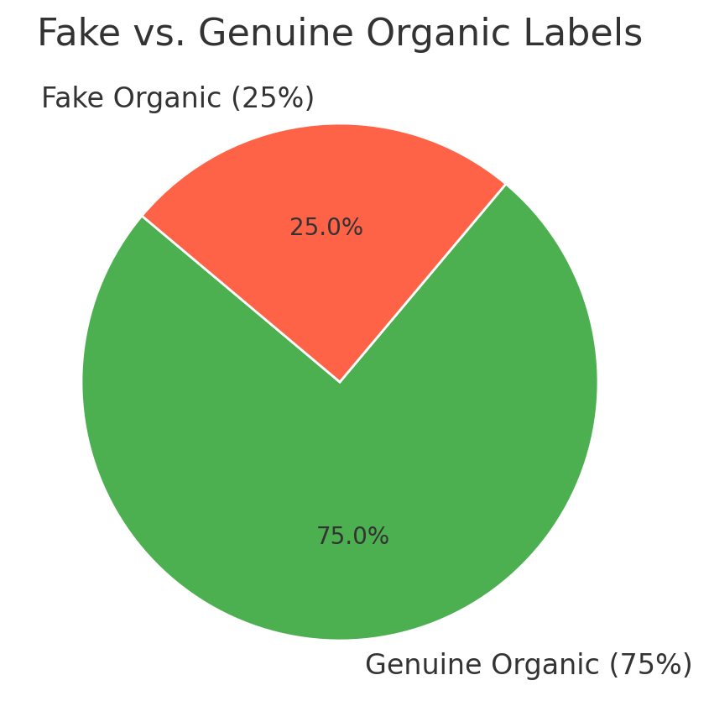
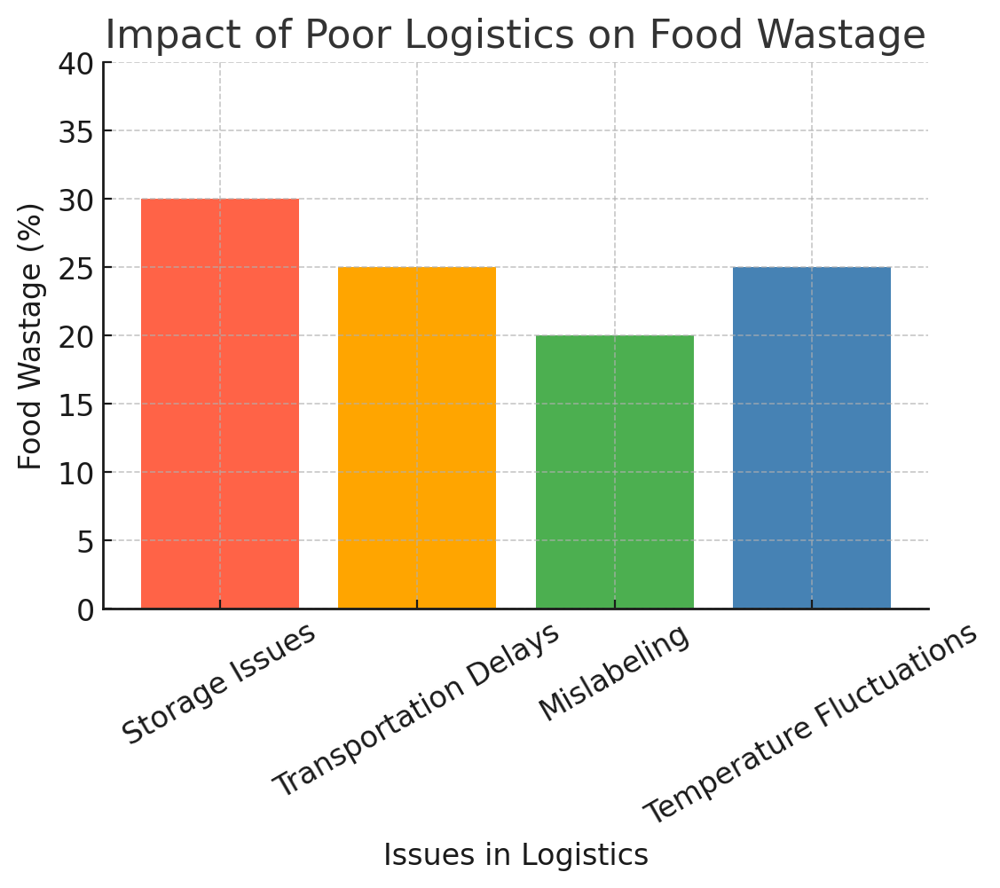
RESEARCH AND STATISTICS

Slide 4
SOLUTION SUMMARY
Our solution is a blockchain-powered traceability system that tracks organic produce from farm to consumer, ensuring transparency, authenticity, and efficient logistics management.
Unlike traditional certification methods, blockchain records every transaction in a tamper-proof ledger, preventing fake organic labelling. Additionally, AI-driven logistics tracking and IoT sensors monitor temperature, humidity, and transit conditions, reducing food spoilage and ensuring freshness.
Our solution integrates blockchain for transparency, AI for predicting market price and , IoT sensors for real time condition monitoring and QR code-based consumer verification, enabling real-time tracking, fraud prevention, and improved supply chain efficiency.

Slide 5
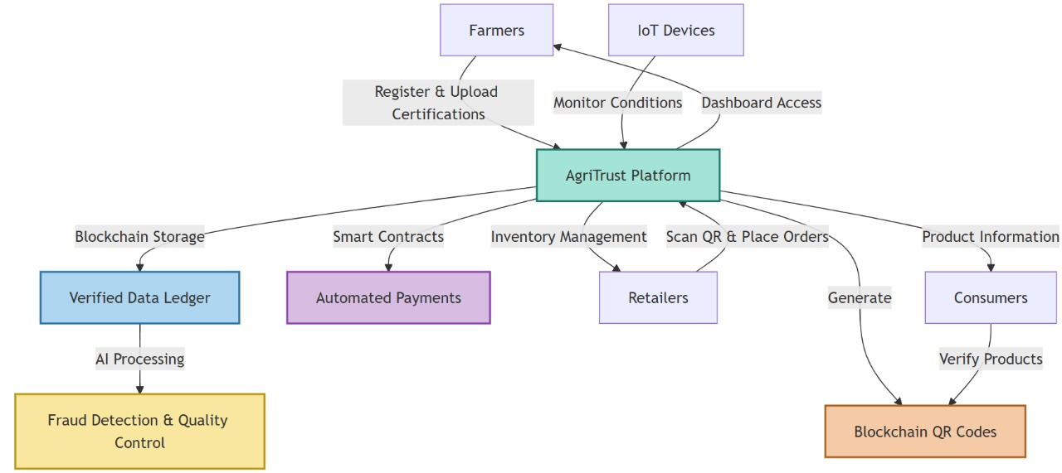

Slide 6
BENEFITS AND POSITIVE IMPACT
Farmers get fair prices and verified organic labeling, increasing their income.
Consumers can verify authenticity using QR codes, ensuring they get what they pay for.
Retailers minimize fraudulent refund claims with real-time freshness tracking.
UNIQUE ADVANTAGES AND DIFFERENTIATORS
Blockchain-powered transparency prevents fraud and mislabeling.
IoT sensors ensure optimal storage and transport conditions.
AI-driven predictive logistics minimizes delays and spoilage.
QR code verification enables easy consumer trust-building.
MEASURABLE OUTCOMES
30% reduction in food wastage due to better logistics tracking.
40% decrease in fraudulent organic labeling through blockchain verification.
20% cost savings for retailers by minimizing refund claims.
Enhanced consumer trust, leading to increased organic food sales.

Slide 7
TARGET AUDIENCE AND POTENTIAL REACH
Farmers – Organic and small-scale farmers looking for fair pricing and authenticity verification.
Consumers – Health-conscious buyers willing to pay a premium for genuine organic products.
Retailers & Supermarkets – Businesses that want to ensure product authenticity and reduce losses from refund claims.
SPECIFIC COMMUNITIES AND GROUPS
Organic farming cooperatives and certification bodies – To ensure credibility.
E-commerce platforms and grocery chains – To integrate traceability solutions.
Food regulatory authorities – For compliance and fraud prevention.
Sustainable living advocates and NGOs – To promote ethical and eco-friendly food supply chains.

Slide 8
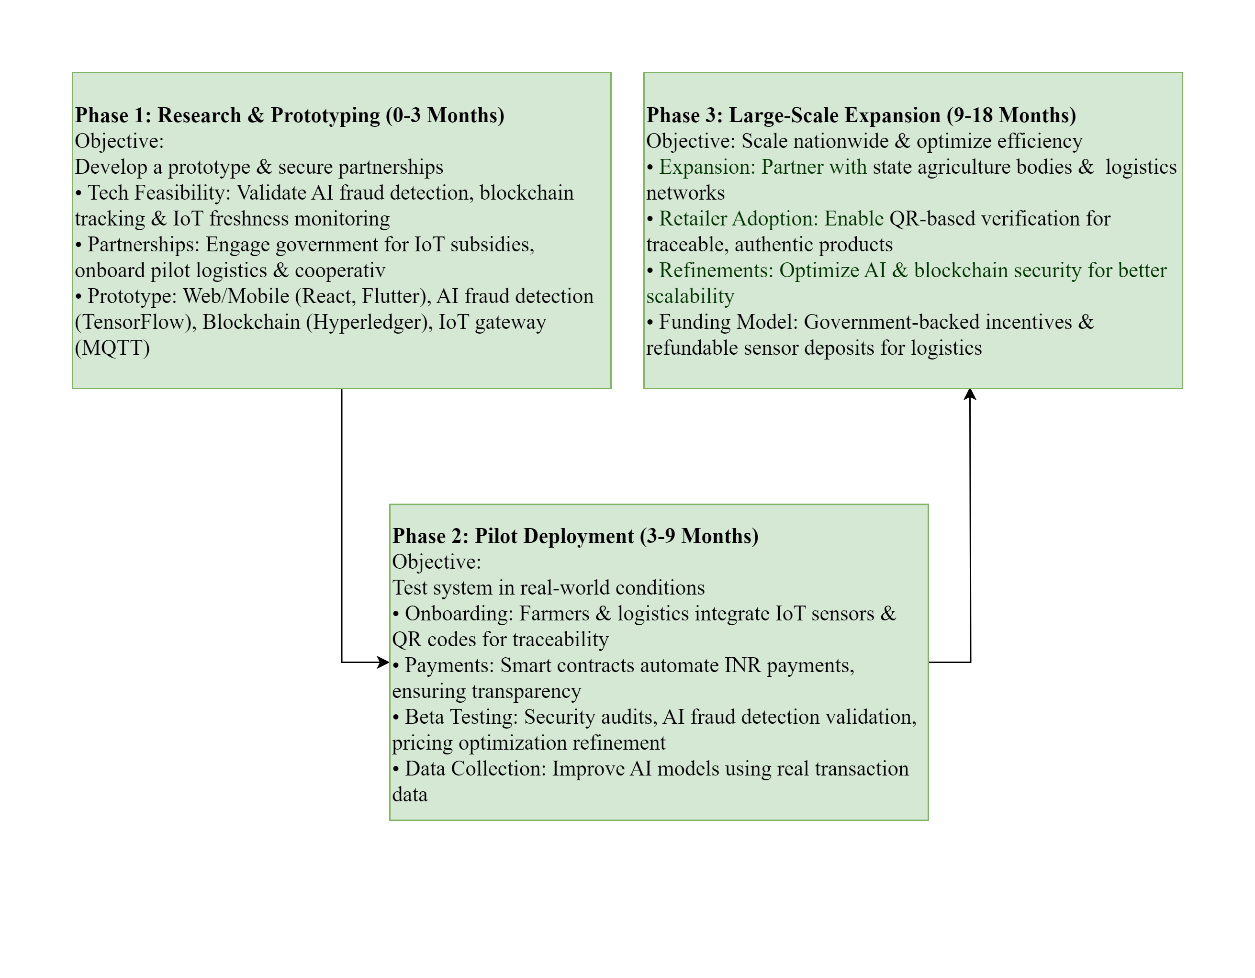
IMPLEMENTATION AND FEASIBILITY

Slide 9
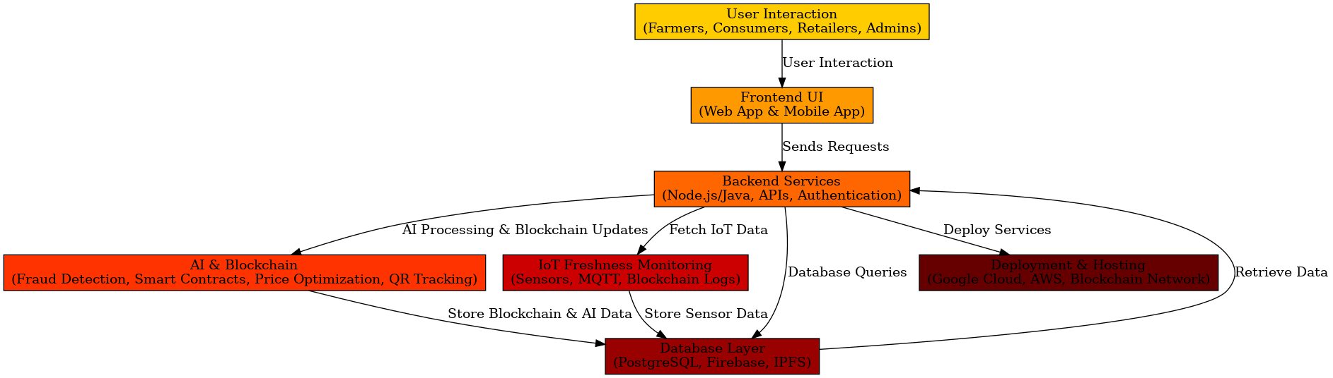

Slide 10
FEASIBILITY AND CHALLENGES
Why It Works?
Proven Tech
Govt. Backing
High Market Demand
⚠ Challenges & Mitigation:
Adoption Resistance → Incentives for early users
Sensor Retrieval → Deposit-based refund for logistics
Cost Management → Layered blockchain & cloud for efficiency

Slide 11
CALL TO ACTION AND NEXT STEPS
Join Us in Transforming the Agricultural Supply Chain!
What We Seek: Feedback & Insights – Help us refine the solution for better adoption Government & Industry Partnerships – Support for subsidies, logistics, and retail integration Pilot Collaborators – Farmers, cooperatives, and logistics providers willing to test the system
Next Steps:
Prototype Refinement & Pilot Execution – Deploy IoT sensors, blockchain traceability & AI fraud detection
Regulatory & Funding Support – Work with government bodies for subsidy integration Scaling & Retail Adoption – Expand nationwide, ensuring trusted, traceable, and fair trade for all
Why This Matters? Empowers Farmers – Ensuring fair pricing & trust in organic produce Prevents Fraud & Waste – Transparent farm-to-table tracking Builds Consumer Trust – AI & blockchain-backed authenticity
Be a Part of the Change – Let’s Build a Smarter, Fairer Agriculture Ecosystem Together! 🌱

Slide 12

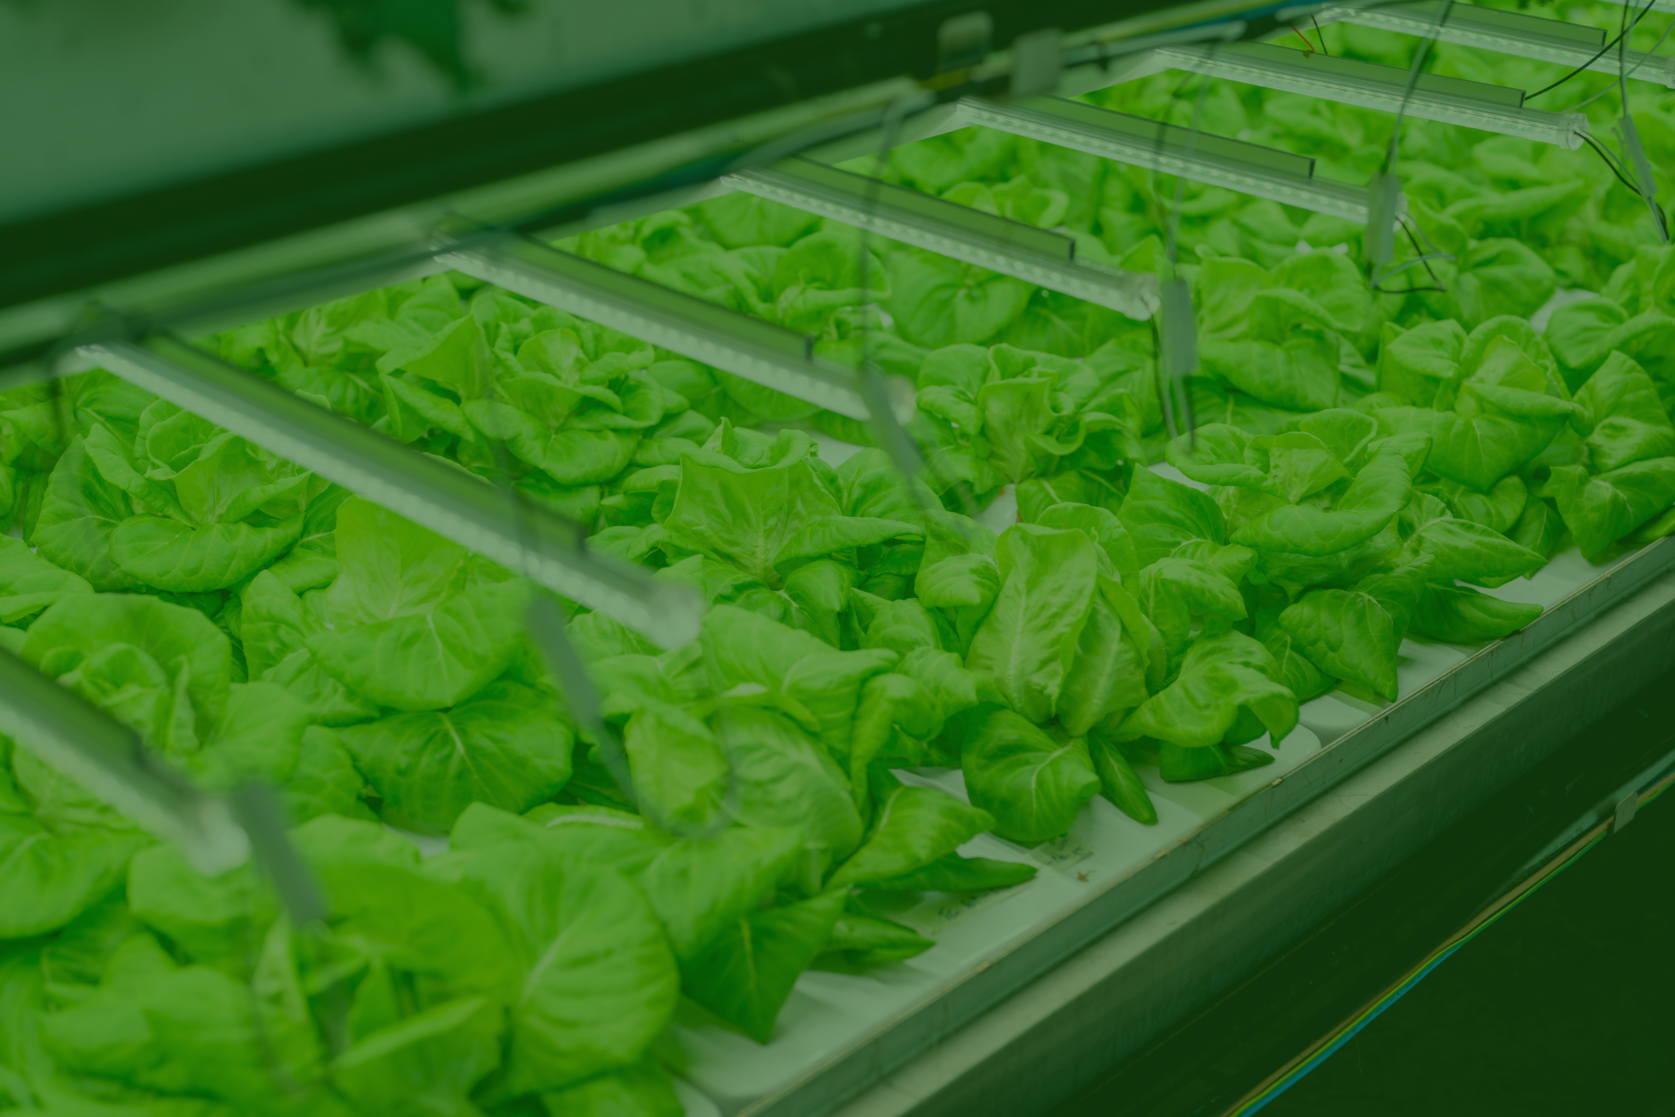

THANK YOU

